Slide 1
JSON-LD
JavaScript Object Notation for Linked Data

Slide 2
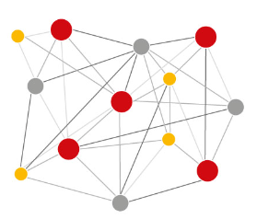
Problem
collection of interrelated datasets on the Web
How can we built a semantic web?
RDF (The Resource Description Framework) is a language for representing information about resources in the World Wide Web
Web 2.0 not linked data
context RDF / JSON-LD
Web 3.0 linked open data
Next Slide

Slide 3
What is JSON-LD?
JSON-based syntax
JSON-LD = „JavaScript Object Notation for Linked Data“
JSON-LD is a concrete RDF syntax
RDF provides a framework of grammar (Syntax)
Using this grammar, RDF syntax can be written in various concrete formats which are called RDF serialization formats e.g. JSON -LD
Important: RDF = data model (Framework) | JSON-LD = serialization format

Slide 4
What is JSON-LD?
JSON-LD combines JSON as data exchange format with RDF as data model framework
data is exchanged as simple JSON data, and a context record specifies how to convert the JSON data to RDF

Slide 5
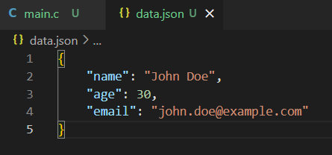
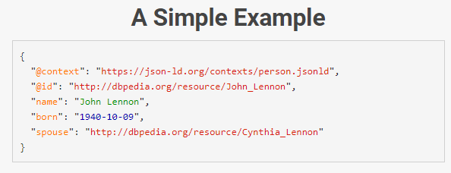
Example
The basic idea behind JSON-LD is that of context (@context), which allows data and data types to be transferred to another syntax - in particular from JSON to the RDF model.
Various data and information such as persons, addresses, appointments or other types of resources are provided with semantic markup so that they are available in machine-readable form and can be further processed in this way
→JSON-LD can be used to annotate data so that it can be exchanged between web applications and web services and processed automatically

Slide 6
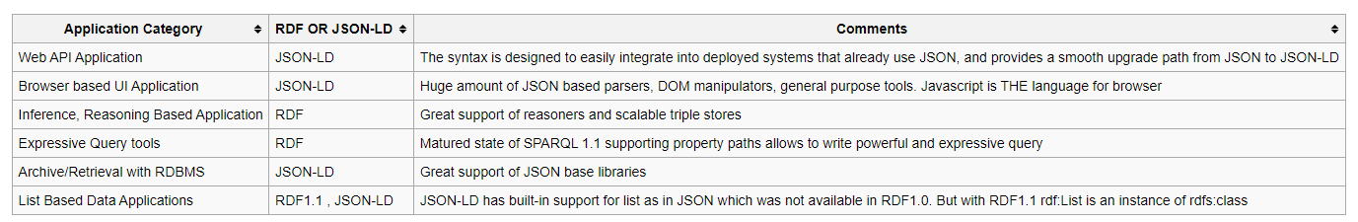
Use Cases

Slide 7
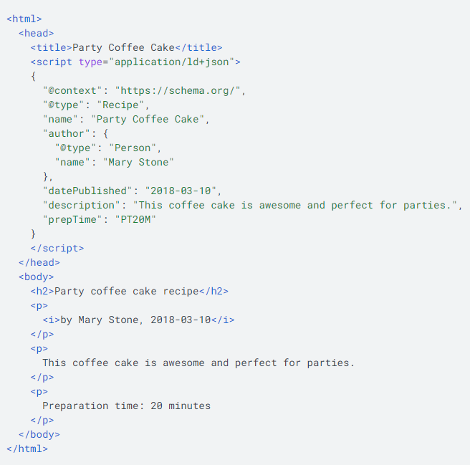
Embedding of JSON-LD in websites
JSON-LD starts with:
“@context”: “https://schema.org/”
Embedding in the head of a website / body also possible
“@type”: “Article”
The @type keyword specifies the type of type you are referring to. In this case, to an article.
Notes:
- CONTEXT: Google, Bing, Yahoo and Yandex have agreed on a uniform vocabulary called "schema.org
- TYPE: Under @type are properties that add attributes to the specified type - e.g. the URL of the article, the headline or the author.

Slide 8
Advantages vs. Disadvantages of JSON-LD
Advantages | Disadvantages
Easy to use - for users who are less familiar with the details of Linked Data technology or the use of inline markup (via RDFa or Microdata), they can be provided with JSON-LD templates that can be inserted as a single block of structured data within the <head> element of a web page. | because the it is more difficult for search engines to verify that the JSON-LD structured data is consistent with the visible human-readable information and that the JSON-LD block does not contain misleading information.
the single block of JSON-LD markup is decoupled from the human-readable HTML markup appearing in the <body> of the page, which means that if changes are made to the structure of the <body> section, there is much less risk of breaking or misconnecting the collection of RDF triples that can be extracted from the page. | because the single block of JSON-LD does not appear alongside the human-readable information, faceted browsers can not easily display contextual hyperlinks in close proximity to the annotated content, although overall, the same set of RDF triples is available in the page.
many companies already use JSON within their websites. Via the @context header of JSON-LD, any locally named properties / keys / predicates can be mapped to specific predicates in defined web vocabularies or ontologies, making the meanings of local names for properties globally unambiguous and also enabling the local structured data to be converted into RDF triples that can be exchanged with others, without ambiguity.
Notes:
Advantages:
They only need to populate the template with the correct data values. Since many data-driven websites are already using templates for the human-readable content of the <body> section of the web page, it should be fairly straightforward for them to include an additional template within the <head> section and use the same data to populate both the existing template for human-readable information and the new JSON-LD template for the machine-interpretable information.
---
This means that a block of JSON-LD data can continue to work with JavaScript local to the website or web application that only makes use of locally-defined names for properties, while also serving as a serialisation format for RDF triples that can be consumed and used by other external applications that might not otherwise know the precise meaning of locally defined names of properties.

Slide 9
Examples why use stuctured data on websites?
Rotten Tomatoes added structured data to 100,000 unique pages and measured a 25% higher click-through rate for pages enhanced with structured data, compared to pages without structured data.
The Food Network has converted 80% of their pages to enable search features, and has seen a 35% increase in visits.
Rakuten has found that users spend 1.5x more time on pages that implemented structured data than on non-structured data pages, and have a 3.6x higher interaction rate on AMP pages with search features vs non-feature AMP pages.
Nestlé has measured pages that show as rich results in search have an 82% higher click through rate than non-rich result pages.

Slide 10
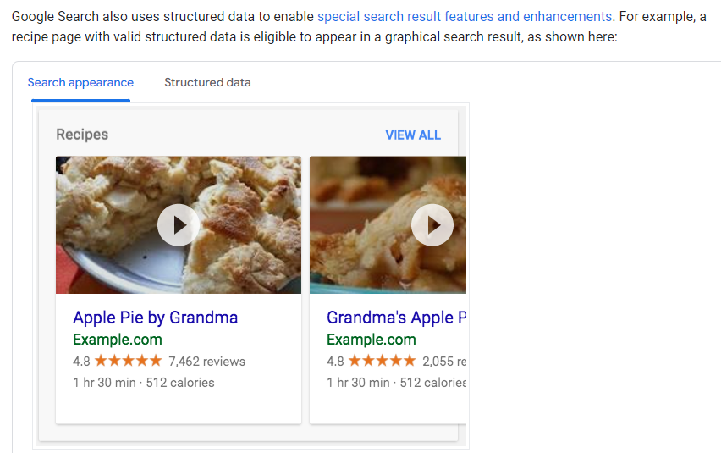
Examples why use stuctured data on websites?

Slide 11
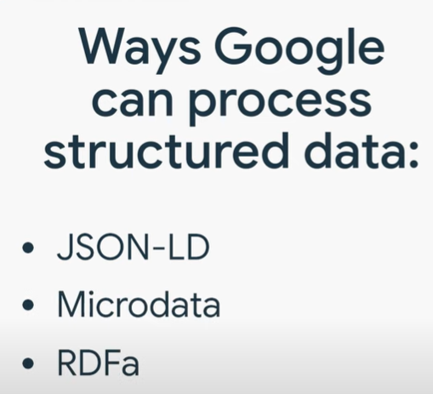
Summary
JSON-LD tries to stay as close as possible to the usual use of JSON as a data exchange format for web developers
JSON-LD with its advantages is the most widely used format
Is preferred by google
Adding structured data can enable search results that are more engaging to users and might encourage them to interact more with your website, which are called rich results

Slide 12
Sources
https://en.wikipedia.org/wiki/Linked_data
https://json-ld.org/
https://www.w3.org/2013/dwbp/wiki/RDF_AND_JSON-LD_UseCases
https://www.omt.de/suchmaschinenoptimierung/json-ld/
https://developers.google.com/search/docs/appearance/structured-data/intro-structured-data?hl=de

